Slide 1
Genetics
Patterns of Inheritance

Slide 2
Genetics Vocabulary
Genetics-The branch of biology that studies heredity
Gene- A unit of genetic material that determines a trait
Allele- Alternate form of the same gene
Heredity- The passing of physical characteristics from parent to child/offspring
Traits- Characteristics that are inherited
Inherit- To acquire a trait from your parents
Carrier- An individual that carries one gene for a recessive trait. (A carrier does not express that trait, but when mated with another can produce offspring that do.)

Slide 3
More Vocabulary
Chromosome-a thread-like strand in the nucleus that controls the cell activity and carries the genetic material to pass traits to offspring
Phenotype- The actual characteristics that an organism demonstrates
Genotype- The allele combination an organism contains
Punnett square-a visual diagram that demonstrates the possible genotypes person could inherit from the parents
Gregor Mendel- Austrian monk who studies pea plants and figured out the rules of heredity. The “father” of genetics

Slide 4
Even MORE Vocabulary
Dominant gene/allele- Strong form of a gene, which is expressed even if a recessive gene is present
Recessive gene/allele- The weak form of a gene, which is not expressed when the dominant form is also present
Meiosis- Cell division that happens in sex cells only. Produces gametes have one set of unpaired chromosomes
Heterozygous- Having 2 different alleles for a trait (also known as hybrid)
Homozygous- Having 2 of the same alleles (also known as purebred)

Slide 5
Last Page of Vocabulary (I PROMISE!)
Gamete- Sex cell
Sex-linked Trait- A recessive trait carried on the X chromosome
Co-dominant- Two(2) alleles of a gene pair in a heterozygote that are both fully expressed
Incomplete dominance- A condition that results when genes produce a trait somewhere in between the trait of the parents
Karyotype- A picture of a person’s chromosomes
Mutation- A change in DNA or chromosomes
Polygenic- A trait that requires more than one gene
Pedigree- A line of ancestors; visual representation

Slide 6
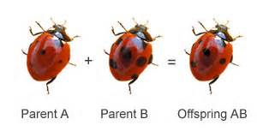
Genes
Organisms always have 2 copies of each gene
the one they inherited from their biological mother
the one they inherited from their biological father.

Slide 7
Levels of Expression
Genes have varying levels of expression
Dominant Genes
Affect the physical appearance or traits of the organism
Recessive Genes
Effects are hidden when a dominant gene is present

Slide 8
What is a Genotype?
A person's genotype refers to the combination of genes he/she inherited.
There are 3 genotypes
Heterozygous
Homozygous dominant
Homozygous recessive.

Slide 9
Genotypes
RR = homozygous dominant (the individual has 2 dominant versions of the gene)
Rr = heterozygous (the individual has 1 dominant version and 1 recessive version of the gene)
rr = homozygous recessive (the individual has 2 recessive versions of the gene)

Slide 10
What is a Phenotype?
A person's phenotype refers to the physical manifestation of his/her genes
For instance, a person with a 'Rr' genotype would have a tongue-rolling phenotype since the presence of a dominant gene allows for the dominant expression of that trait

Slide 11
Phenotypes vs Genotypes
The way an organism looks and behaves is called its phenotype. This is a physical trait.
The allele combination an organism contains is known as its genotype. This is a genetic trait that may not be seen.
Three (3) examples of possible representations
PP (two capital letters)
Pp (one capital letter, one lowercase letter)
pp (two lowercase letters

Slide 12
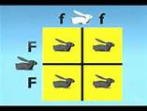
Dominant and Recessive
Genes are often represented by using single letters
CAPITAL letters represent the dominant genes
lower case letters represent recessive genes

Slide 13
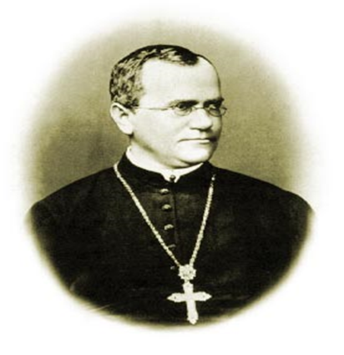
The Father of Genetics
Gregor Mendel, an Austrian monk, carried out important studies of heredity—the passing on of characteristics from parents to offspring.
Characteristics that are inherited are called traits.

Slide 14
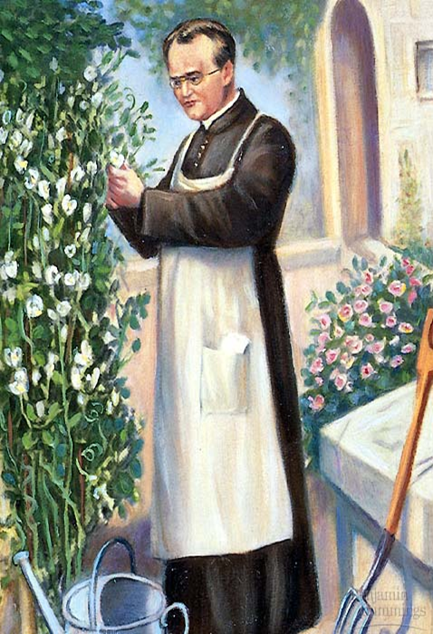
Mendel’s Principles
Modern genetics began with Gregor Mendel’s quantitative experiments with pea plants
Mendel crossed pea plants that differed in certain characteristics and traced the traits from generation to generation

Slide 15
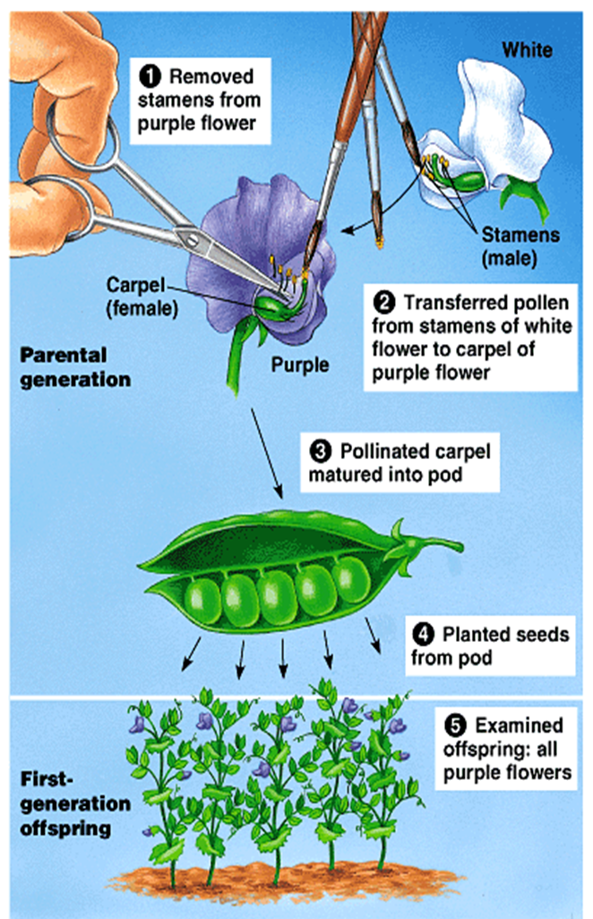
Mendel Chose His Subject Carefully
This illustration shows his technique for cross-fertilization

Slide 16
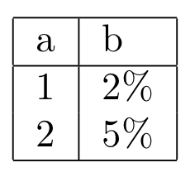
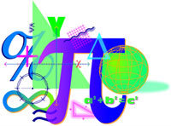
Mendel was a Careful Researcher
He studied only one trait at a time to control variables, and he analyzed his data mathematically.
Variable- A factor that can influence the outcome of an experiment
Probability-the percent chance of inheriting a trait
Ratio-relation in degree or number between two different things

Slide 17
Mendel’s Research
The tall pea plants he worked with were from populations of plants that had been tall for many generations and had always produced tall offspring.
Such plants are said to be true breeding
A hybrid (heterozygous) is the offspring of parents that have different forms of a trait, such as tall and short height.

Slide 18
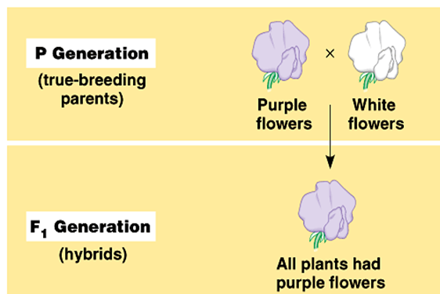
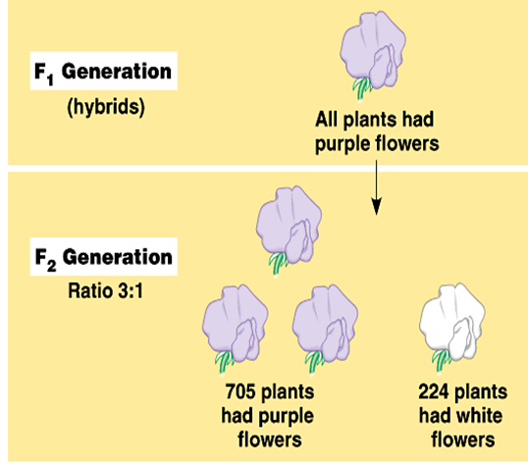
Mendel’s Laws of Heredity
The original parents, the true-breeding plants, are known as the P₁ generation.
The offspring of the parent plants are known as the F₁ generation
When you cross two F₁ plants with each other, their offspring are the F₂ generation

Slide 19
Mendel’s Principle of Segregation
Mendel’s principle of segregation describes the inheritance of a single characteristic
From his experimental data, Mendel deduced that an organism has two genes (alleles) for each inherited characteristic
One characteristic comes from each parent
A sperm or egg carries only one allele of each pair
The pairs of alleles separate when gametes form
This process describes Mendel’s law of segregation

Slide 20
The Rule of Dominance I
If two (2) alleles differ, then one (1), the dominant allele, is fully expressed in the organism’s appearance.
The other, the recessive allele, has no noticeable effect on the organism’s appearance.
Purple color is dominant over white

Slide 21
The Rule of Dominance II
An uppercase letter is used for the dominant allele and a lowercase letter for the recessive allele.
The dominant allele is always written first.
An organism is homozygous for a trait if its two alleles for the trait are the same. PP (dominant) or pp (recessive)
An organism is heterozygous for a trait if its two alleles for the trait differ from each other. (Pp) (dominant)

Slide 22
Punnett Squares
In 1905, Reginald Punnett, an English biologist, devised a shorthand way of finding the expected proportions of possible genotypes in the offspring of a cross
A Punnett square predicts the results of a genetic cross between individuals of known genotype

Slide 23
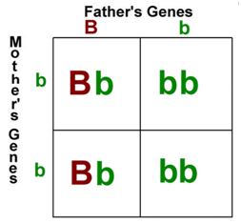
Punnett Square
A Punnett Square is a diagram used to determine the possible genetic combinations of the child resulting from the cross of two individuals.
The male genotype is written on the top
The female genotype is written on the side

Slide 24
Hair Color Punnett Square
Father with a 'Bb' genotype
Mother with a 'bb' genotype
Each box represents one(1) possible outcome for the child resulting from the cross
“b” controls blonde hair
“B” controls brown hair

Slide 25
Results of Hair Color Punnett Square
Since…
Bb= Brown hair
bb= blonde hair
Then there is a…
2/4, or 50%, chance that the child resulting from this cross would have brown hair
2/4, or 50%, chance that the child resulting from this cross would have blonde hair.

Slide 26
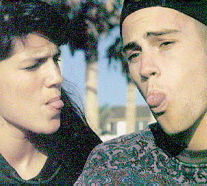
Tongue Rolling genetics
Can everyone roll their tongue?
Let’s work it out and see!

Slide 27
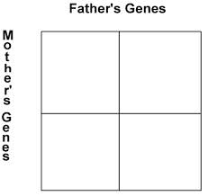
Who’s a Tongue roller?
Let’s say …
The father’s genotype is Rr
R
r
Rr
rr
r
The mother’s genotype is rr
r
Rr
rr

Slide 28
What Are The Results?
We can determine that there is a 50% chance that the child will be a tongue roller
We can determine that there is a 50%chance that the child will NOT be a tongue roller
WHY?
The father’s genotype is dominant
The mother’s genotype is recessive

Slide 29
Can everyone roll their tongue?
NO! It is an inherited trait!
If a person has one dominant and one recessive tongue-rolling gene, their genotype could be written as 'Rr.‘
If a person inherited two recessive tongue-rolling genes, their genotype would be written as 'rr.'

Slide 30
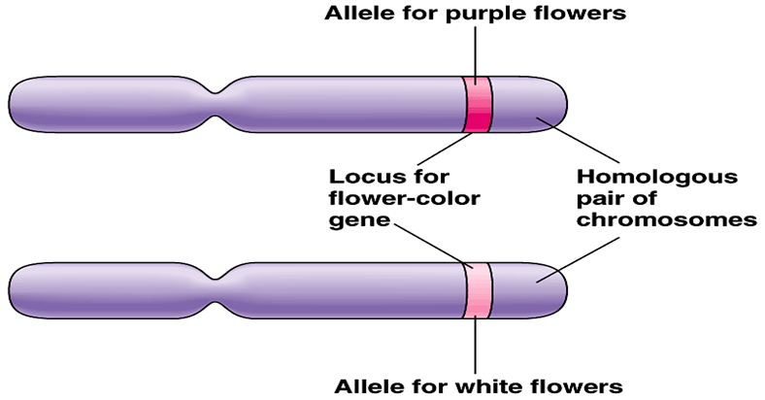
Homologous Chromosomes
Alternative forms of a gene (alleles) reside at the same locus on homologous chromosomes

Slide 31
Principle of Independent Assortment
The principle of independent assortment is revealed by tracking two characteristics at once
By looking at two characteristics at once, Mendel found that the alleles of a pair segregate independently of other allele pairs during gamete formation

